Slide 1
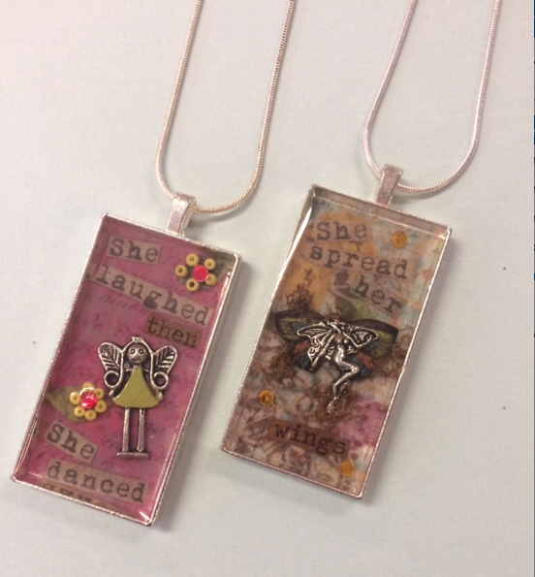
with
Crafting
Friends
(of the Library)
Create a customized Collage Necklace while enjoying wine and desserts with friends…. all while supporting the Friends of Queen Anne’s County Library’s efforts to enhance programming at the Kent Island and Centreville libraries.
Attendees will be provided with professional instruction and all the supplies (including pendants, and a huge selection of decorative papers, charms, beads, and more) to design and make a unique necklace.
Event Details
Tuesday, August 2, 2016
7:00pm – 9:00pm
Wye River Designs Studio
4300 Main Street, Grasonville
Cost (for supplies, instruction, wine & snacks):
$25 – Friends of the Library members
$30 – Non-members
Interested in joining the Friends? Annual membership +
event registration = $50
RSVP by July 28 at
http://friendsofqaclibrary.org/event/crafting-with-friends/
Pay online or mail check to
FOQACL, PO Box 482, Grasonville MD 21638
Seating is limited!

